Slide 1


Ever felt the need for some method to keep you focused?
Have you ever
been distracted easily during online classes?

Slide 2

If you are a lecturer, ever wasted time taking attendance?

Slide 3
DistracNot Team Hocus-Focus
Faerie Srivarshan Ashvath

Slide 4
Project analysis slide 10
Challenges identified by
Students in online learning

Slide 5
Project analysis slide 10
Attention span during
Online classes

Slide 6

Project analysis slide 6
Our Solution
Faculty
Prompt students with simple multiple choice questions which are generated in real-time.
Quiz
Students

Slide 7

Project analysis slide 6
Our Solution
while ( class not over )
{
if ( time == 5th minute)
{
}
}
These questions arrive periodically at regular intervals to the students.

Slide 8
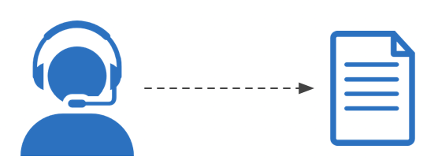
Project analysis slide 6
Our Solution
They are completely auto-generated. The questions will be based on the lecture given by the faculty during an interval.
Faculty Lecture
Questions

Slide 9

Project analysis slide 6
Our Solution
if ( class over )
{
if ( score > 5)
{
}
}
The number of questions answered correctly by a student determines his/her attendance for that class.

Slide 10
Project analysis slide 2
Feasibility
Integration with existing software
Minimal resource utilization
DistracNot
Simple to implement
Gentle learning curve
Less maintenance
Additional server not required

Slide 11








Project analysis slide 3
Tech Stack
Frontend
Backend

Slide 12
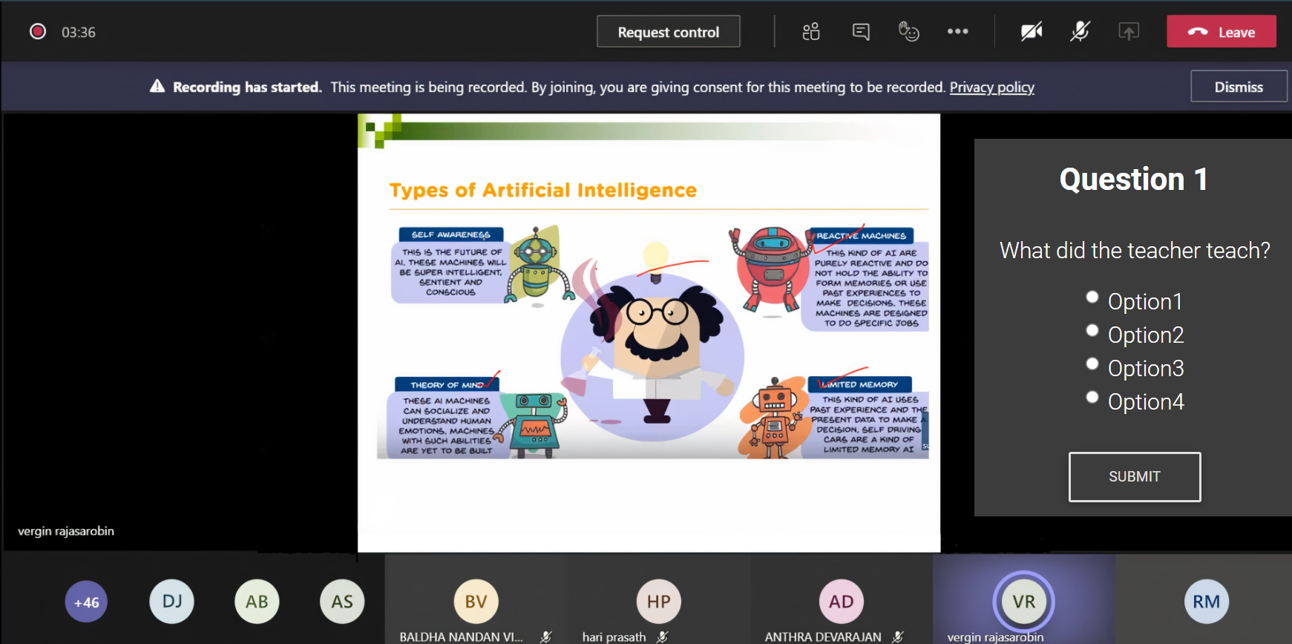
Project analysis slide 6
User Interface
A basic illustration on how the product works alongside Microsoft teams

Slide 13
Thank You

